Slide 1
DRA Municipal Services Tax Rate Setting Software
NH GFOA
Annual Conference
5/7/2015

Slide 2
Disclaimer
This presentation is intended for informational purposes only, and is not a substitute for seeking professional advice or for reviewing the applicable laws and rules. This presentation represents some positions of the Department on the limited issues discussed herein, based on the law in effect at the time of the presentation and Department interpretation thereof, as well as the opinions and conclusions of its presenter.
For the current status of any tax law, practitioners and taxpayers should consult the source documents (i.e., Revised Statutes Annotated, Rules, Case Law, Session Laws, etc.) for independent verification.

Slide 3
Presentation Outline
System overview
First year to date
Improvements to be made
Remaining processes
Revised estimated revenues
Tax rate setting
Overlay and fund balance
Reports
Training and resources

Slide 4
Tax Rate Setting Portal
Launched on 11/17/2014
Usage
Users: 753
Warrants Drafted: 5,847
Number of pre-reviews: 414
Number of completed appropriations: 319
Municipal cooperation and patience vital to process

Slide 5
Tax Rate Setting Portal Goals
More efficiently and effectively manage the tax rate setting process for municipalities and DRA
Electronic filing
Data work flows
Data repository
Extensive reporting/data exports
Fully transparent tax rate calculator
Improve advisor’s ability to provide technical assistance

Slide 6
Basic Process-Towns/Cities
Budget
Appropriations
Rates
PDF
MS-1
Proposed
Appropriations
PDF
MS-232
Tax Rate
Setting
Warrant
PDF
PDF
Warrant
Warrant
Proposed Budget
MS-636
MS-6c
MS-737
MS-535
Warrant
PDF
MS-434
Estimated Revenues
Re-estimate Revenues

Slide 7
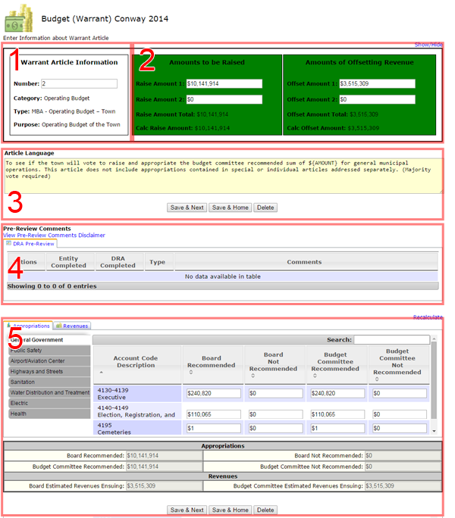
Budget
Warrant article drafting
Pre-review
Aggregation
Previous year values
Supplemental schedules*
Submission

Slide 8
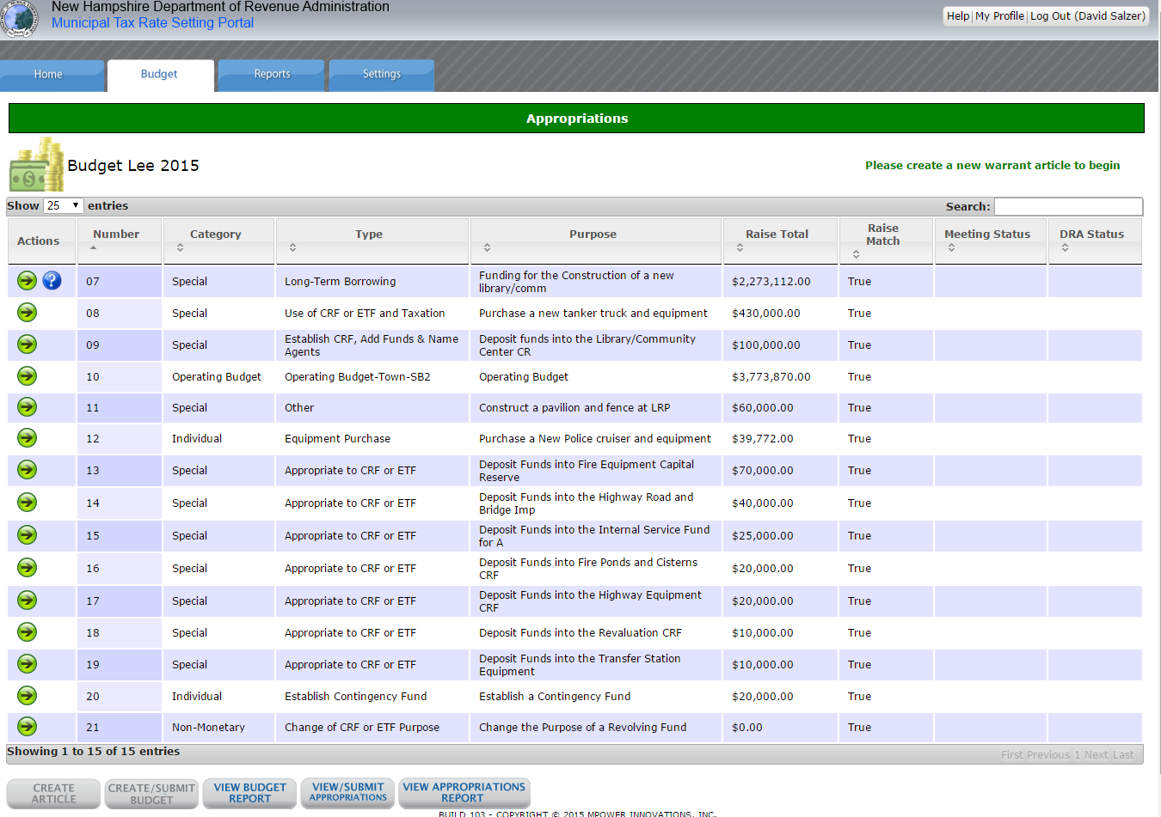
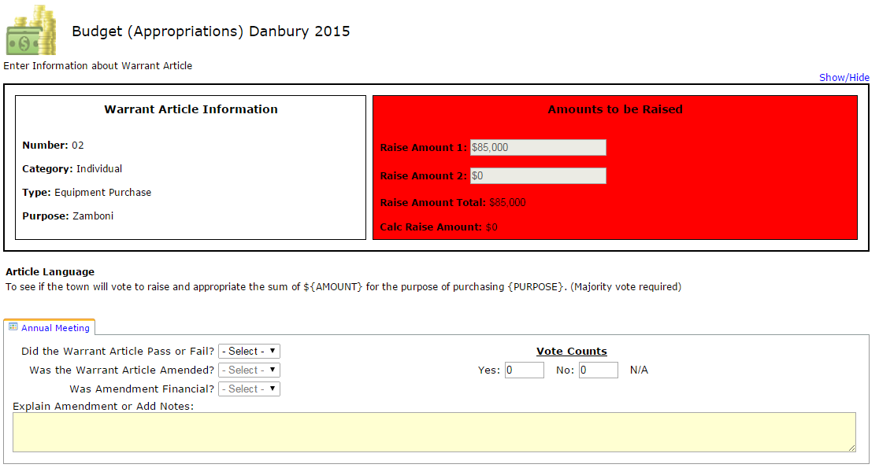
Appropriations
Warrant article conversion
Aggregation
Submission
Form uploads
“R” forms

Slide 9
First Year Hurdles
Common issues that we are working to resolve:
Change to recommended and not recommended value checks in WA generator
Previous year values (specifically for special and individual warrant articles)
Default budget
Supplemental schedules
Uploads
Steep learning curve
Iterative process to make custom software work for a large and varied user group

Slide 10
Recommended Value Checks
Two raise and offset blocks not necessary
Change to
Recommended amount
Not recommended amount
Total proposed amount

Slide 11
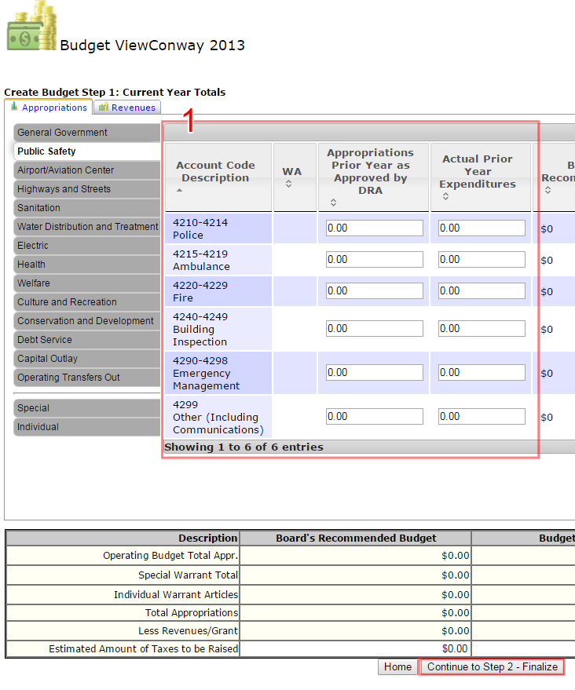
Previous Year Values
Data migration from old system resulted in some minor issues
Ability to show special and individual warrant articles that were in previous budget but not in current year budget

Slide 12
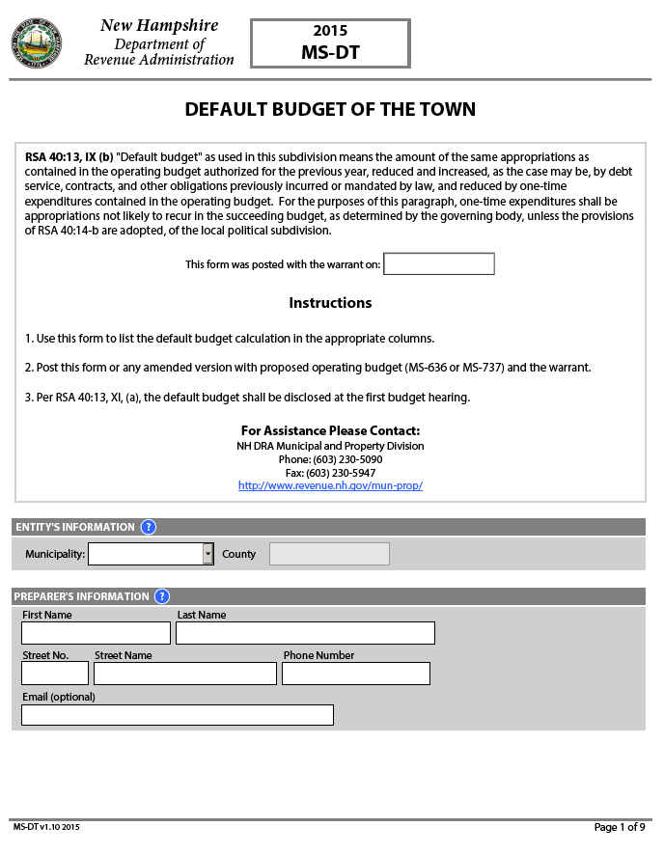
Default Budgets
2015-Two options
Default budget warrant article
PDF form
2016-One option
Default budget warrant article
2017-One option
Default budget process separated from warrant articles

Slide 13
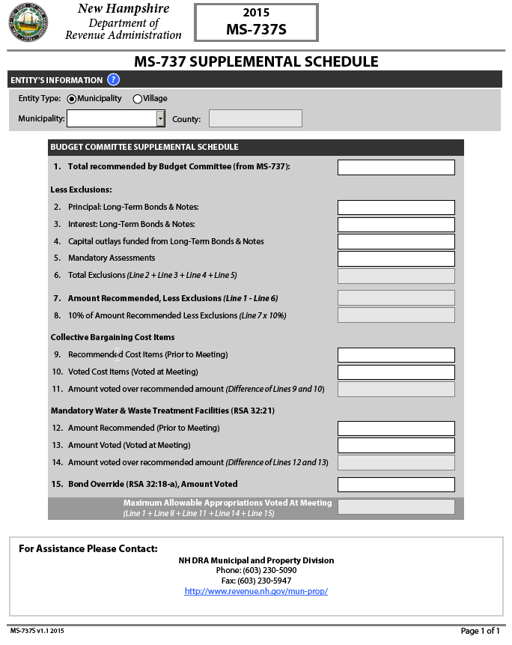
Supplemental Schedules
For MBA only
2015-PDF
Download
Fill out
Upload
2016-Integrated system table

Slide 14
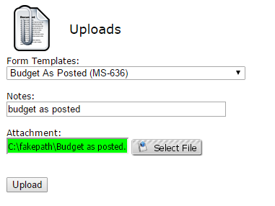
Uploads
Upload file size
Increased to 60 mb
“Rapid clicks” prior to upload completion
Deleting uploaded files

Slide 15
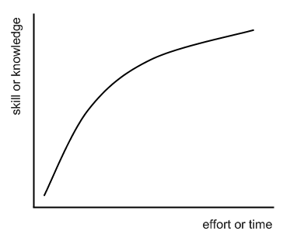
Steep Learning Curve
Wholesale process change
Short time frame
Tight timelines

Slide 16
Basic Process-Towns/Cities
Budget
Appropriations
Rates
PDF
MS-1
Proposed
Appropriations
PDF
MS-232
Tax Rate
Setting
Warrant
PDF
PDF
Warrant
Warrant
Proposed Budget
MS-636
MS-6c
MS-737
MS-535
Warrant
PDF
MS-434
Estimated Revenues
Re-estimate Revenues

Slide 17
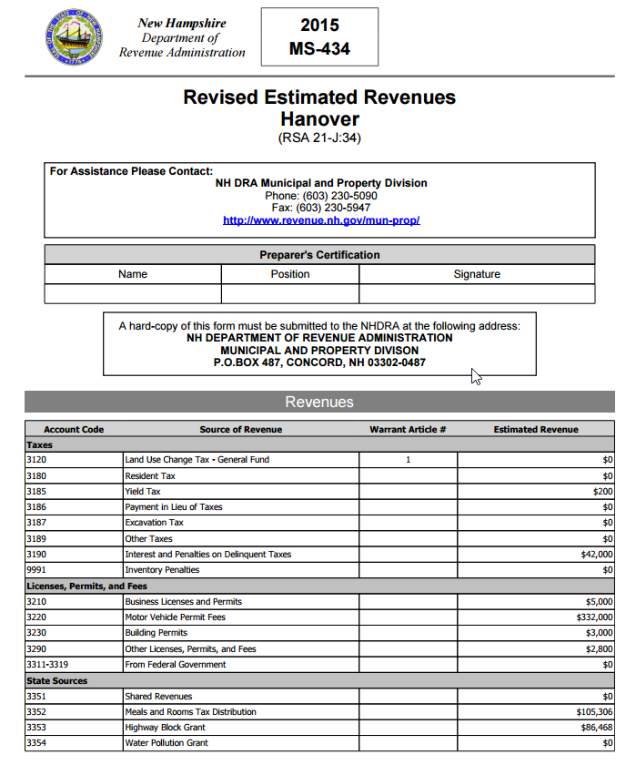
Revised Estimated Revenues
Due September 1
“Updated” revenue values
Baseline values will be pulled from proposed budget in aggregate (not by article)
Print draft forms
Update and submit to DRA as final

Slide 18
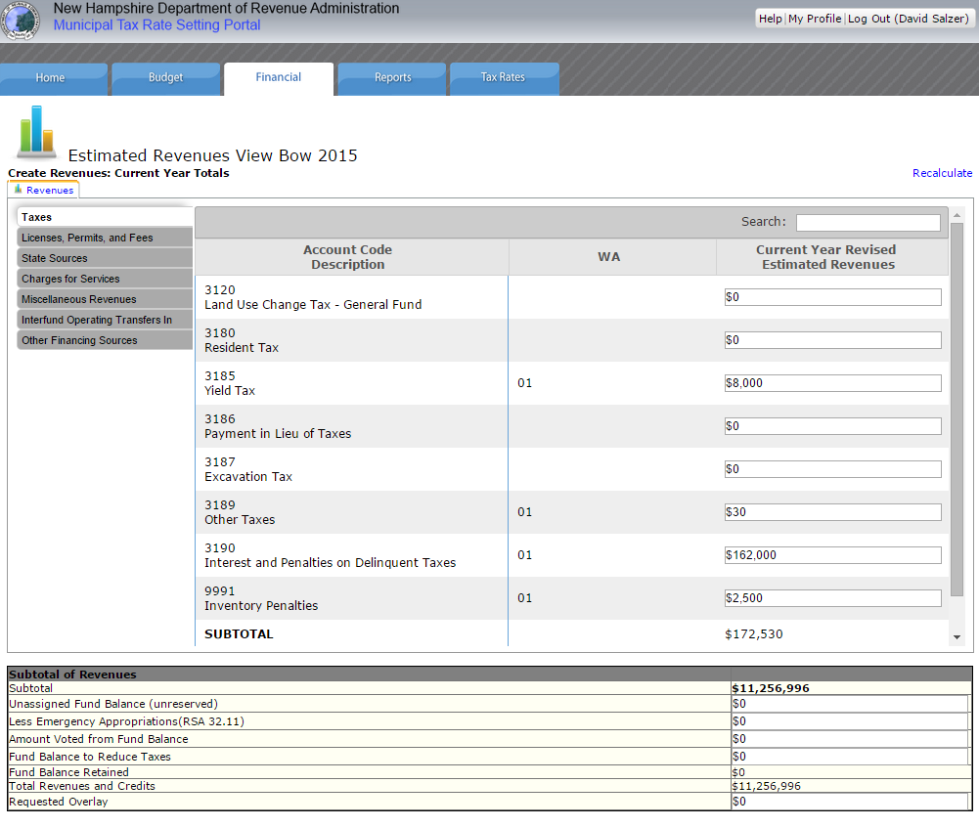

Slide 19
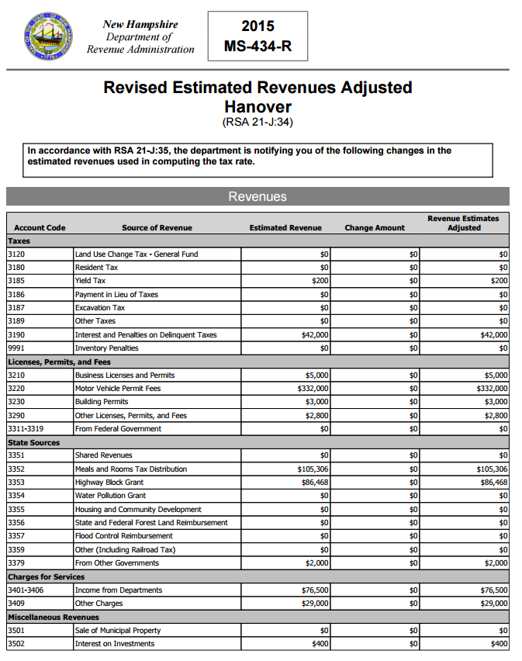
Revised Estimated Revenues
DRA will review submitted values
Make adjustments as necessary
Produce MS-434R which contains revenues that will be used to calculate tax rate

Slide 20
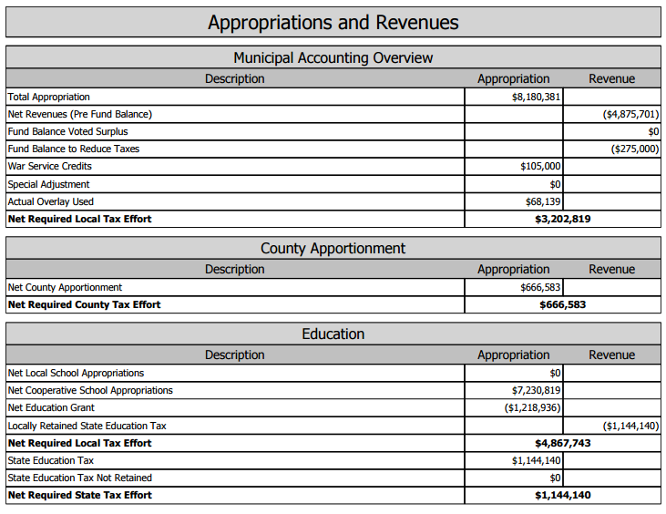
Tax Rate Calculation
Occurs when municipality and all associated entities have filed necessary forms
Process is all web based

Slide 21
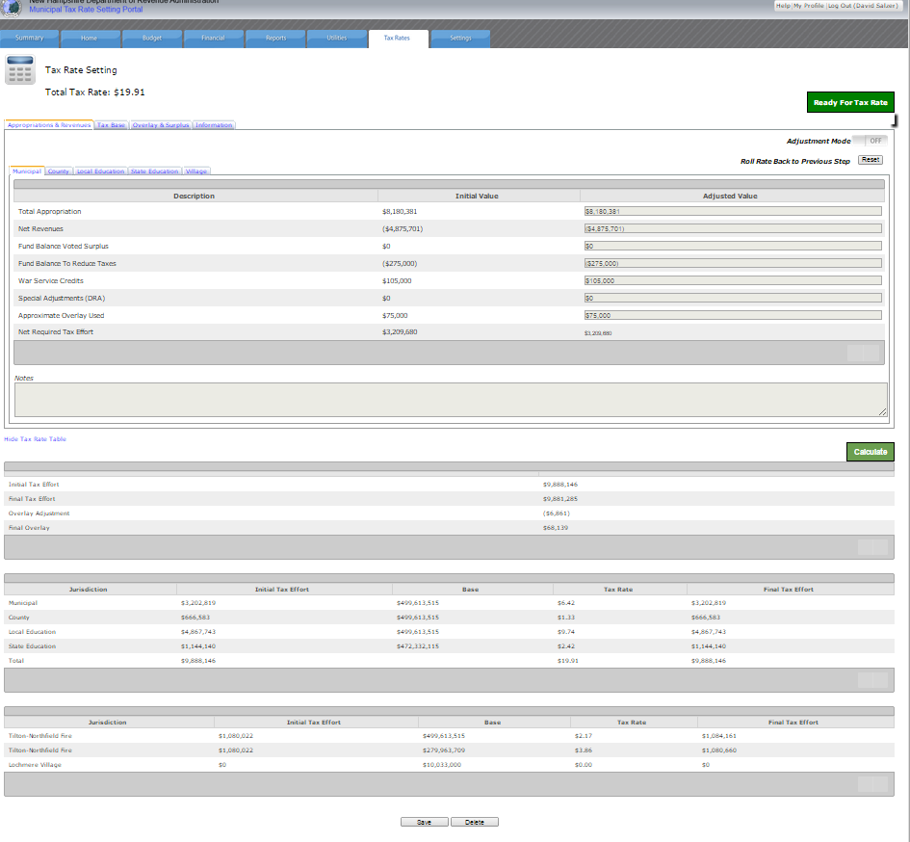
Rate Inputs
Summary

Slide 22
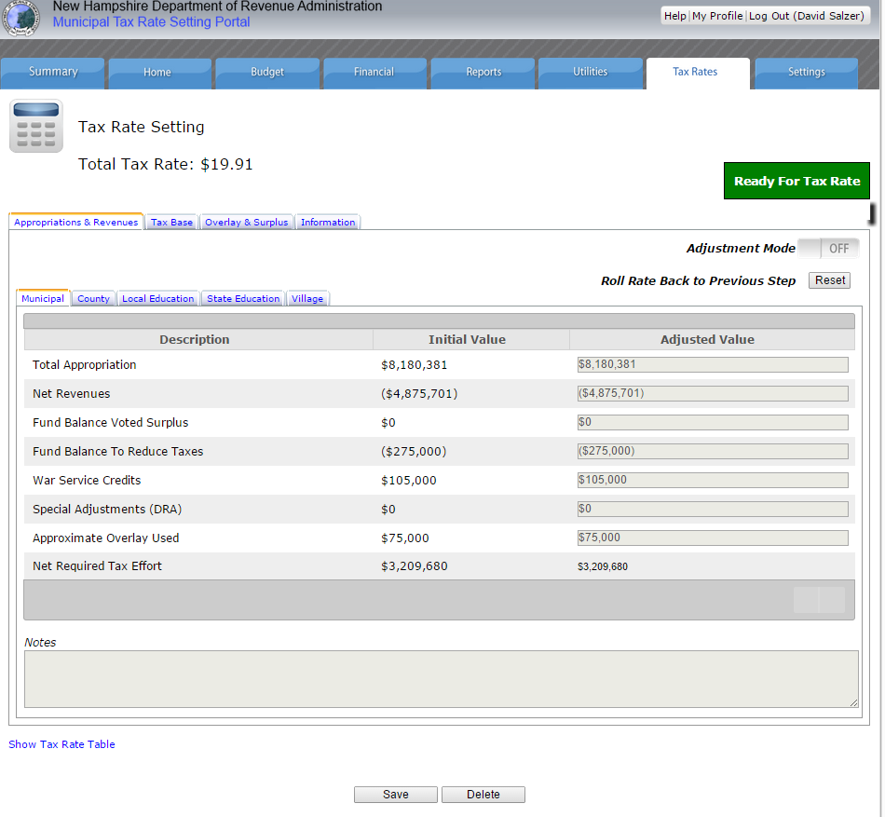

Slide 23
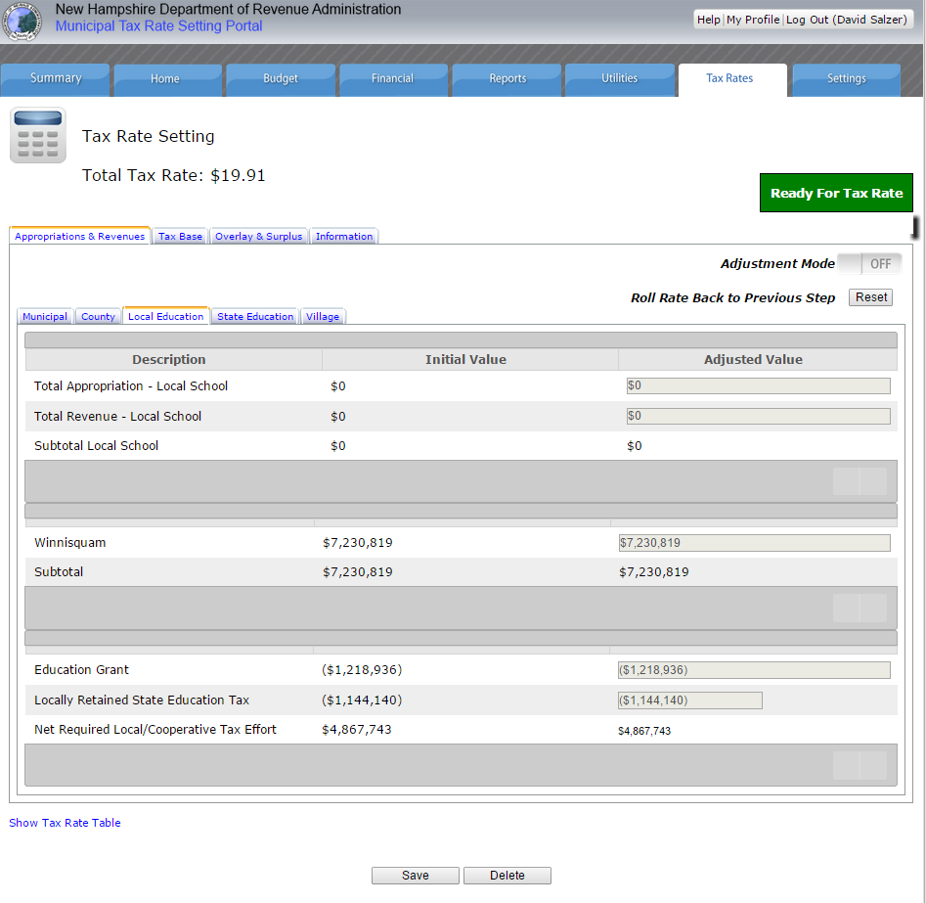
Local
Regional
Summary

Slide 24
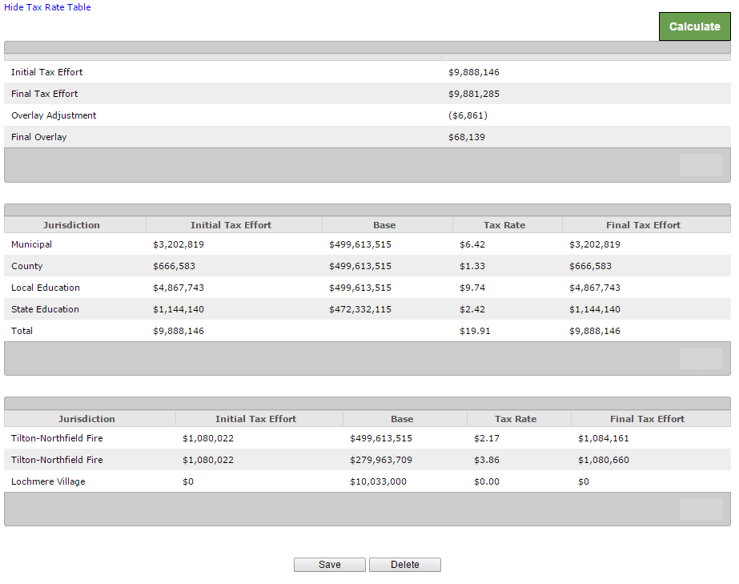
Overlay
Adjustment
Rate
Calculation
Village
Rate
Calculation

Slide 25
Tax Rate Calculation
Advisor sets preliminary rate
Municipality can modify:
Fund balance to reduce taxes
Estimated overlay
Supervisor sets final rate
Director reviews final rate
Municipality notified
Upload signed commitment sheet

Slide 26
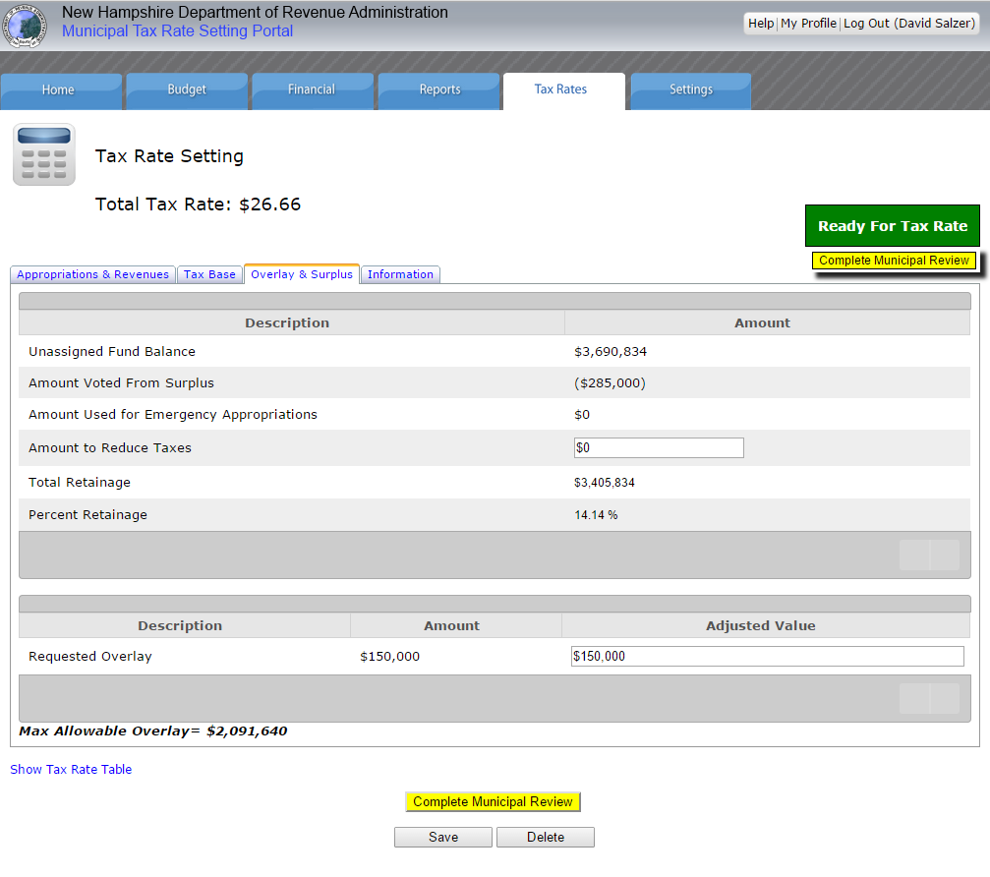
Municipal Interface
Interface to update Fund Balance to Reduce Taxes and Requested Overlay
Calculate impact to tax rate
Return to DRA with updates values

Slide 27
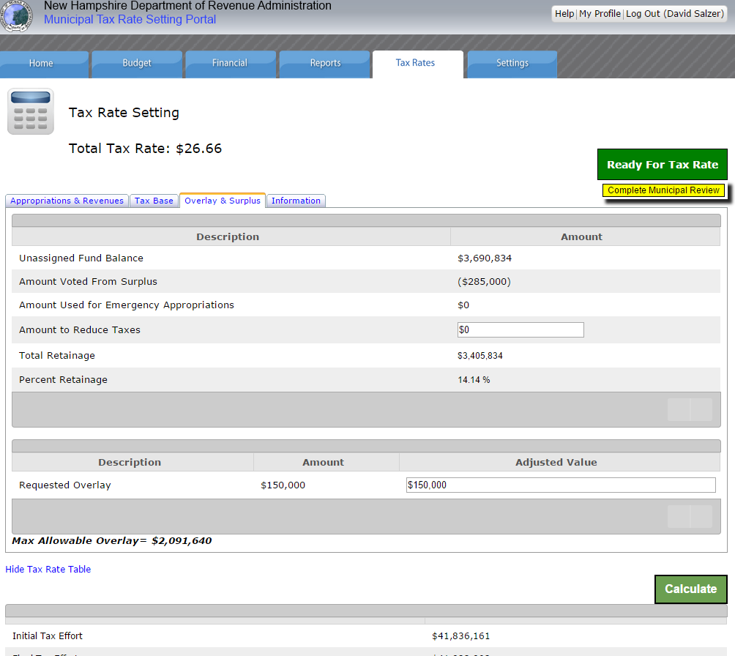
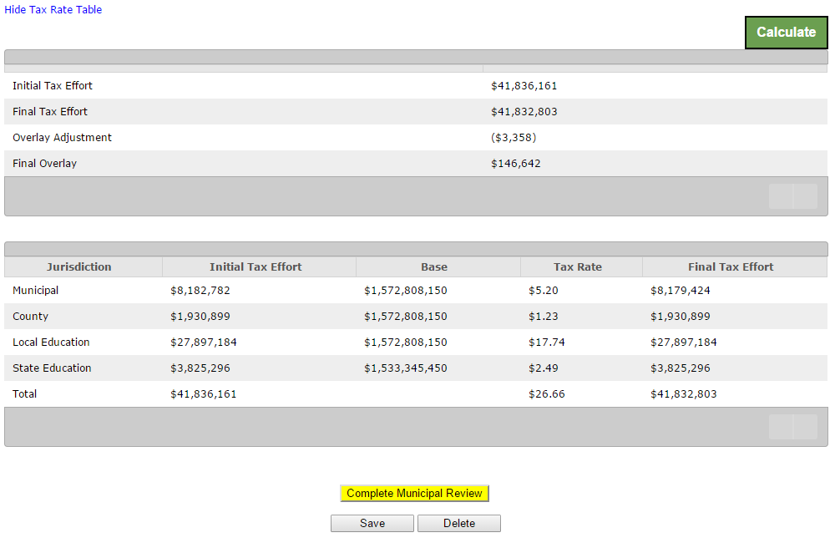
Amount to reduce taxes
&
Overlay adjustments
Rate Calculation

Slide 30
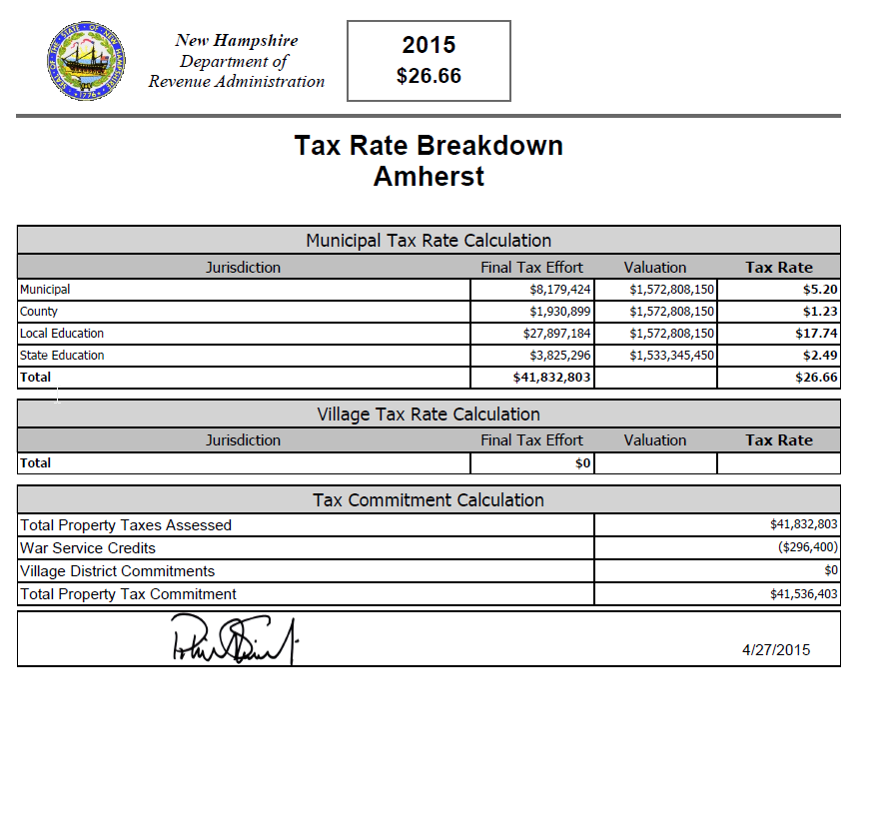
Tax Rate Reports
Printable in draft and final versions
Combined report containing
Rates
Appropriations/revenues breakdown
Commitment sheet
Quarterly/semi-annual billing sheet

Slide 31
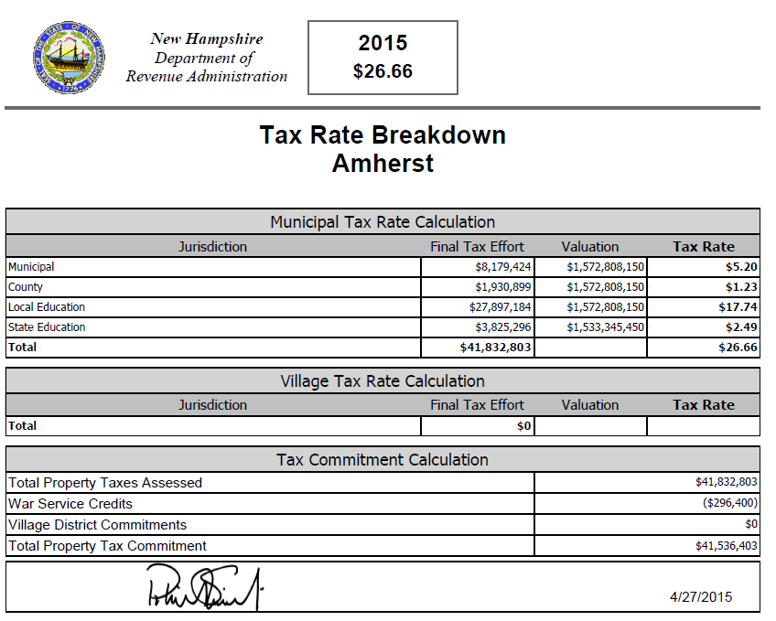
Page 1-Rate Overview

Slide 32
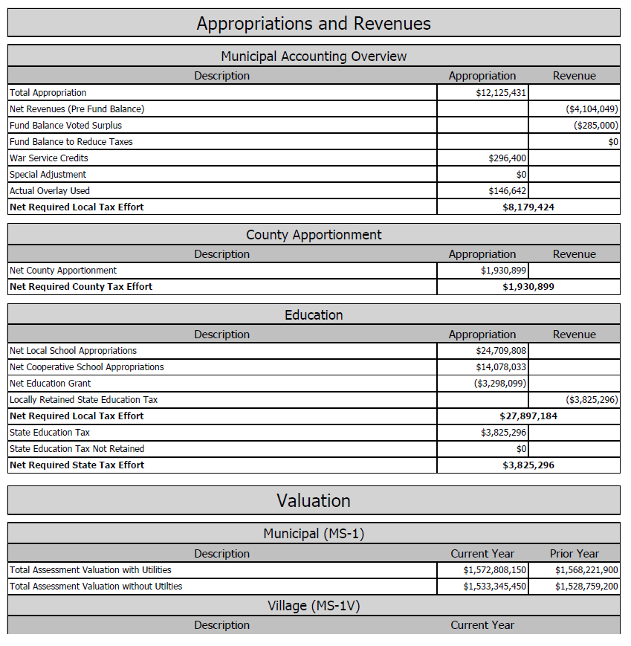
Page 2-Appropriations and Revenues Breakdown

Slide 33
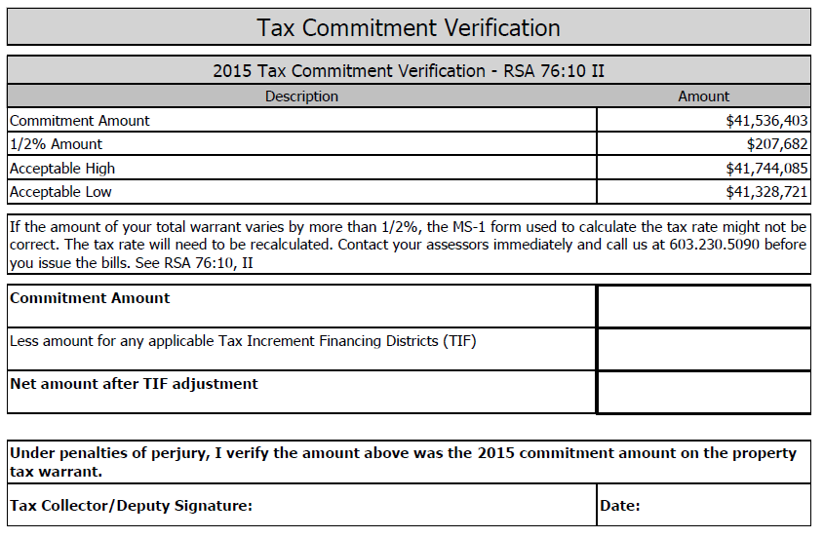
Page 3-Tax Commitment Verification

Slide 34
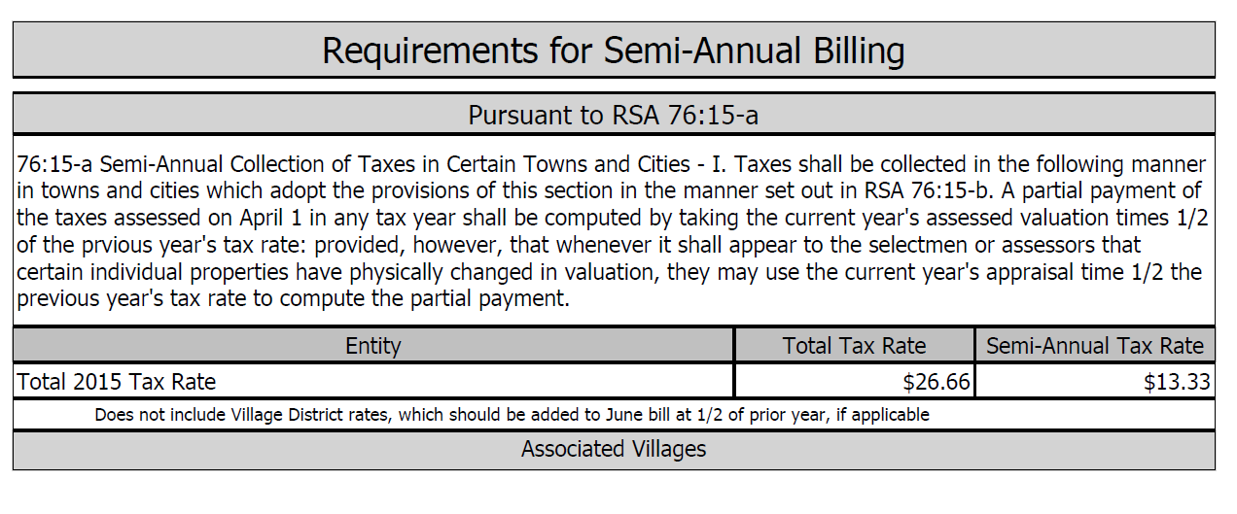
Page 4-Requirements for Semi-annual or Quarterly Billing

Slide 35
Tax Rate
Once the tax rate is finalized by DRA you will be notified via email
Download final report
Sign commitment letter and upload to system
Start the entire process again for 2016!
Head start with warrant article generating…

Slide 36
Data Migration
Bring warrants forward from previous year
2015
2016
Proposed
Appropriations
Warrant
PDF
PDF
Warrant
Warrant
Warrant
Warrant
Warrant
Proposed Budget
MS-636
MS-6c
MS-737
Proposed Budget
MS-636
MS-6c
MS-737
Warrant
Warrant
Estimated Revenues

Slide 37
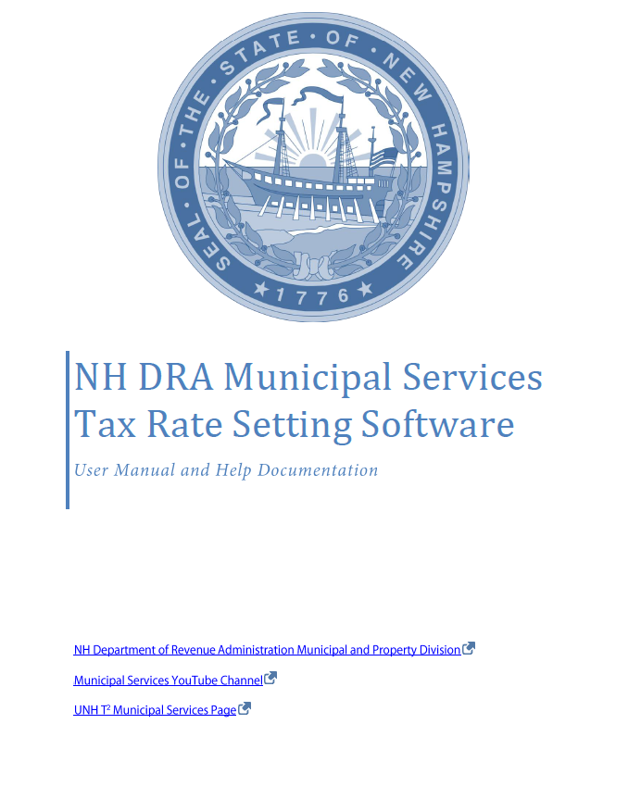
Resources
DRA Website
T² Website
YouTube video series
Municipal advisor
T² staff

Slide 38
Training
Revised Estimated Revenues & Tax Rates
Combined training
Early August through early October
Web and classroom sessions
Sign up online

Slide 39
Questions?

